Slide 1

JIRA (Defect Tracking And Project Management Tool)
Kalindi Bhatia
Hussain Jivani
14-Aug-2015

Slide 2
Topics
1. What is JIRA?
2. Typical Project Life-cycle
3. Overview of JIRA
4. Understanding JIRA Ticket
5. JIRA Walkthrough
6. JIRA Capture Plugin

Slide 3
1. What is JIRA?

Slide 4
What is JIRA?
DEFECT TRACING And PROJECT MANAGMENT tool.
By Atlassian, Inc. (Australian company)
Software project development teams, help desk systems, leave request systems etc.
Applicability to QA teams, it is widely used for bug tracking, tracking project level issues- like documentation completion and for tracking environmental issues.
Confidential | Copyright © Larsen & Toubro Infotech Ltd.
4

Slide 5
2. Typical Project
Lifecycle

Slide 6
Typical Project Lifecycle
End of Warranty
Kick Off
Project
lifecycle
Customer requests add ons or changes
Changes
Design
Phase
Need of changes to SW in Vx version
-> design team and restart the loop
Bug
Tracking
Fix SW in Vx version
-> maintenance team
Develop-
ment
Integraton
&
Testing
Release
Deliver SW in Vx version
Validation & Delivery of SW in Vx version

Slide 7
3. Overview of JIRA

Slide 8
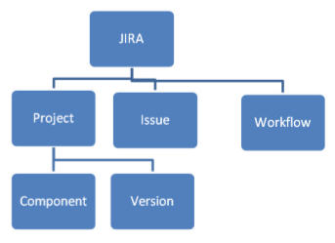
Basics
JIRA in its entirety is based on 3 concepts.
Issue: Every task, bug, enhancement request; Anything created and tracked via JIRA.
Project: Collection of issues
Workflow: Series of steps an issue goes through starting from creation to completion.

Slide 9
Why JIRA?
Need for Tool like JIRA
DEFECTS need to be :
Created
Classified
Assigned
Tracked
Monitored
Analyzed
Closed

Slide 10
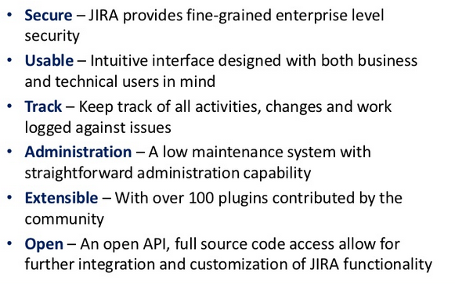
Why JIRA?
Features

Slide 11
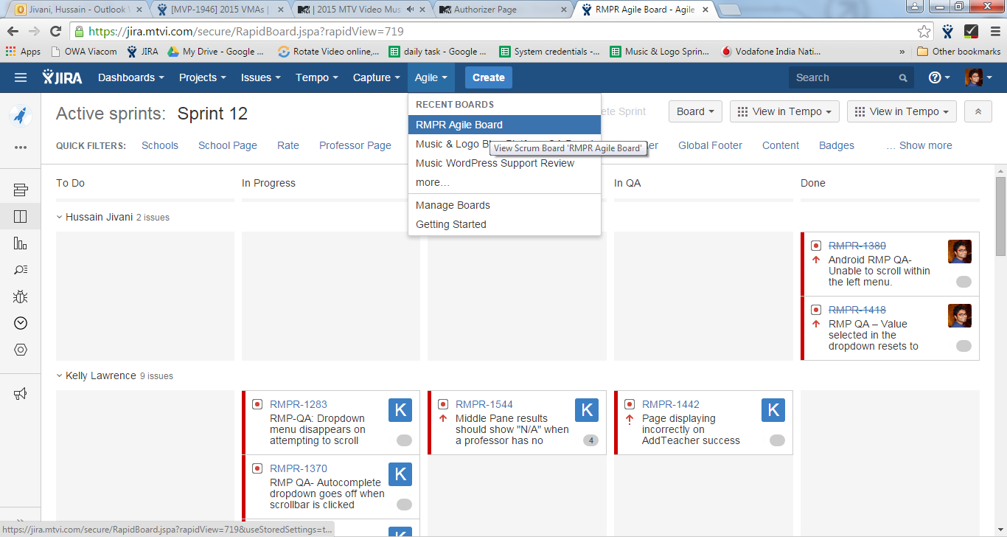
Why JIRA?
Agile Board

Slide 12
4. Understanding JIRA Ticket

Slide 13
How do we work in JIRA?
Basically we deal with tickets in JIRA.
Tickets can be of any of the Issue types viz. story, bug, task, sub-task.
User story is nothing but a task of QA or development that needs to be carried out with every kind of detail.
Defect which is referred as ‘Bug’ or an ‘Issue’ in JIRA, is also a type of a ticket.
So for any given defect that we observe while testing, we raise a JIRA ticket.

Slide 14
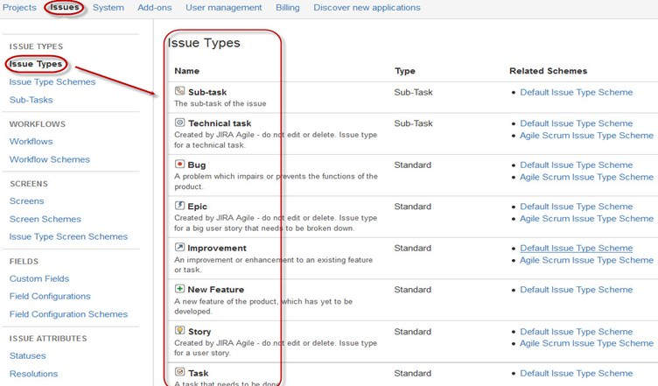
Issue Types

Slide 15
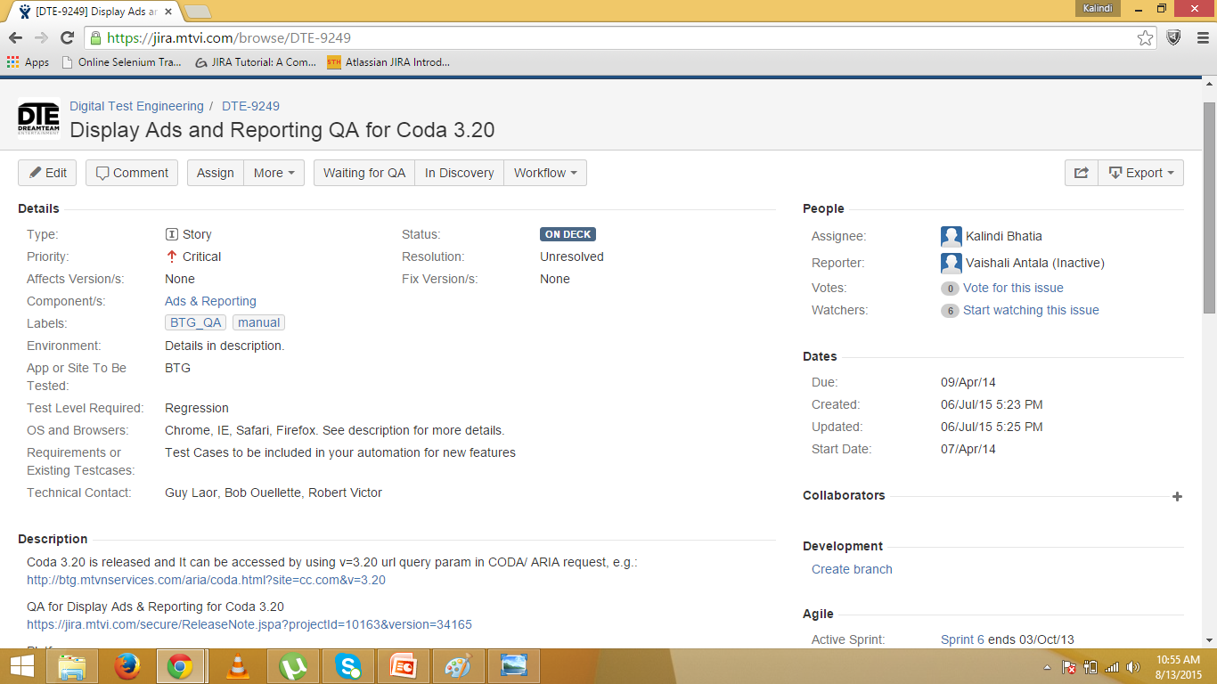
Sample User Story

Slide 16
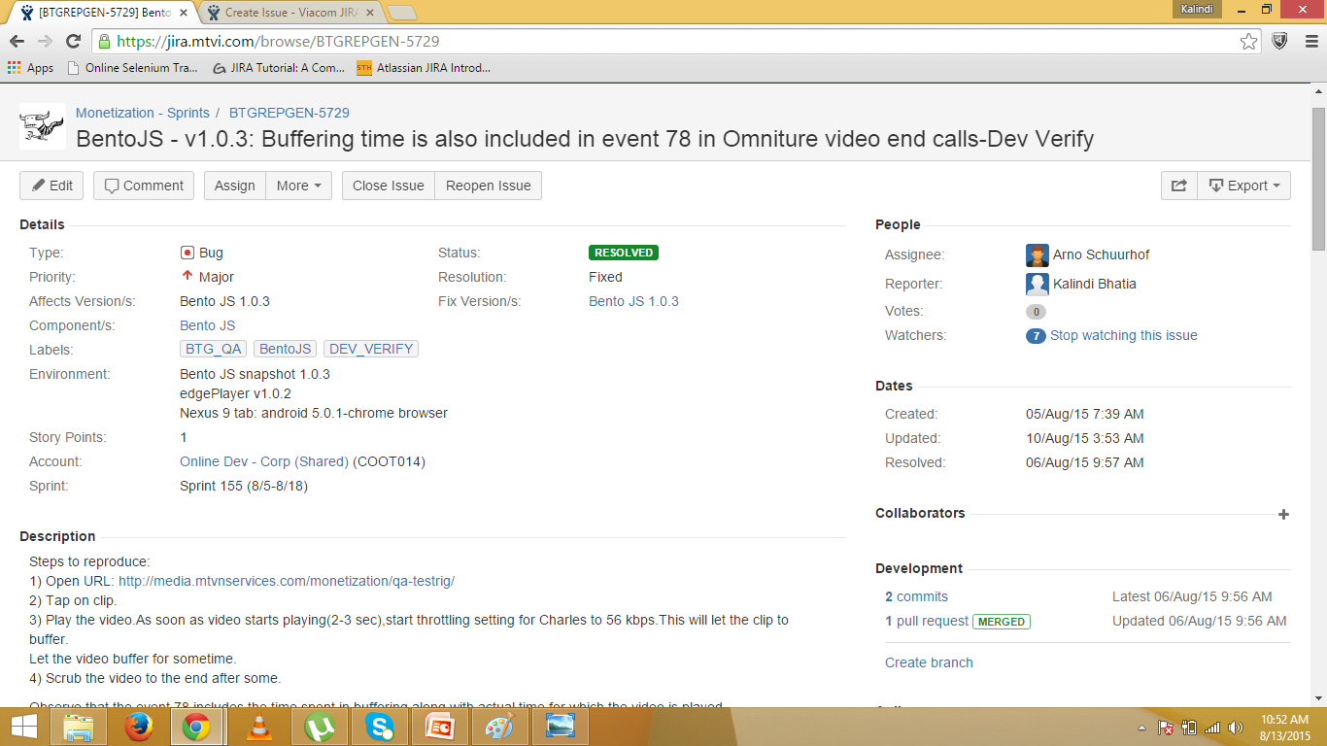
Sample JIRA defect

Slide 17
Exploring a JIRA Ticket
Common fields for any Ticket:
Type
Priority
Affect Versions
Test cases/requirements
Test level required
Environment
Site/App to be tested
Status
Resolution
Story points
Assignee
Reporter
Watchers

Slide 18
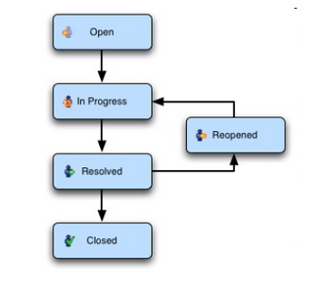
Workflow for any Ticket created in JIRA

Slide 19
5. JIRA Walkthrough

Slide 20
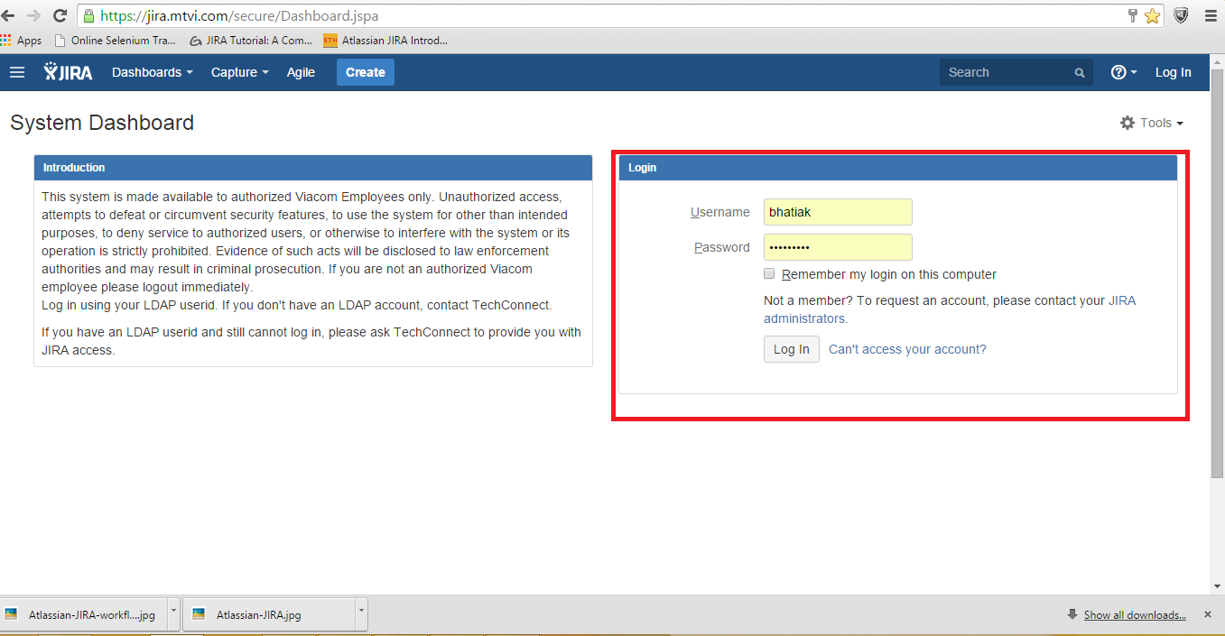
Walkthrough on JIRA
Login Screen

Slide 21
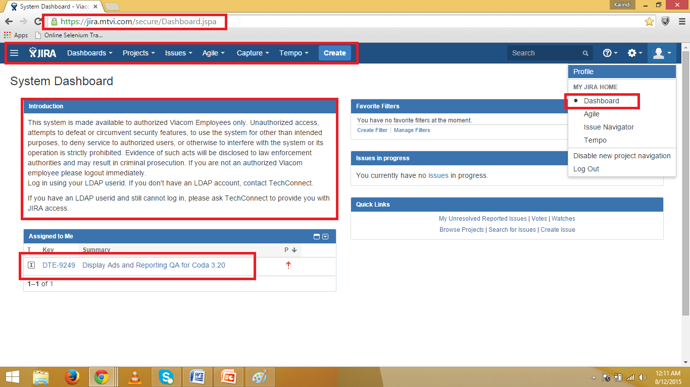
Dashboard View (Home screen)
System Dashboard

Slide 22
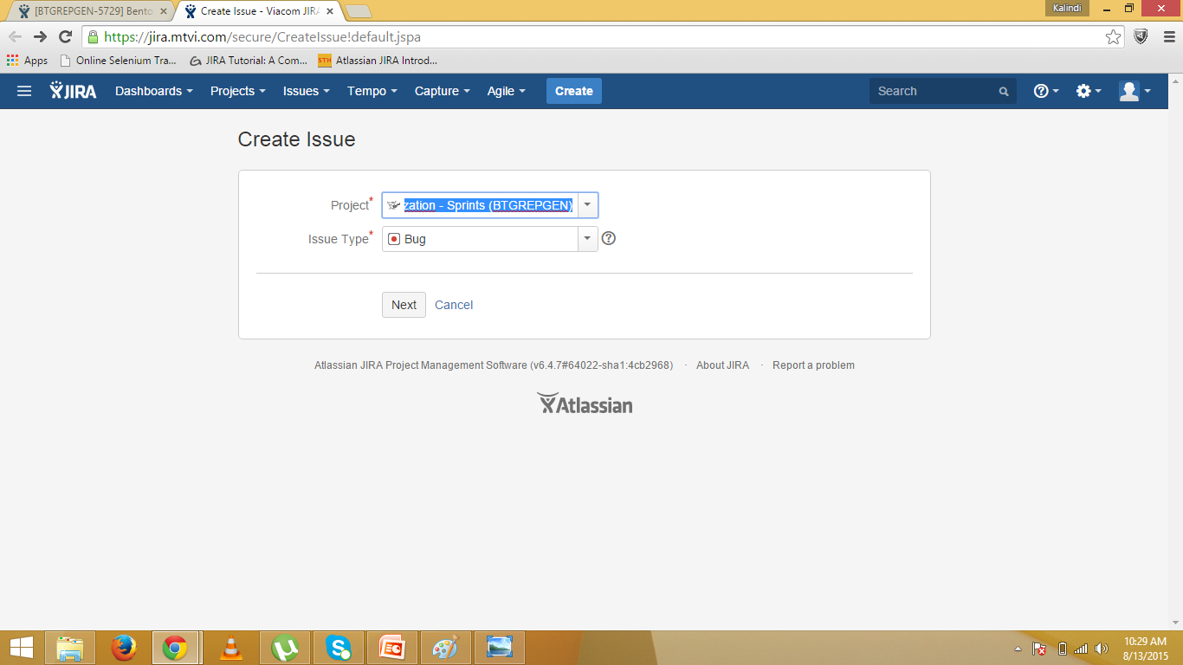
Creating an Issue i.e. Defect .. (1)

Slide 23
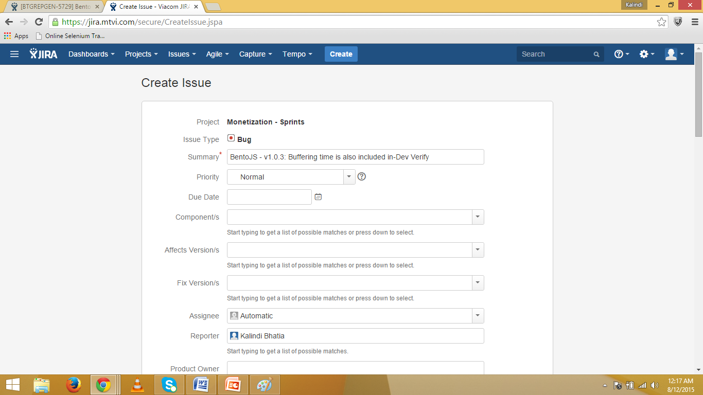
Creating an Issue i.e. Defect .. (2)

Slide 24
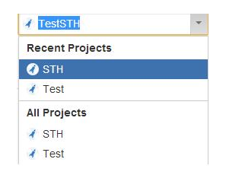
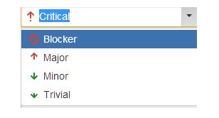
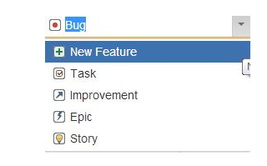

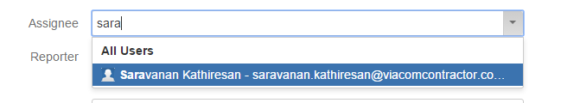
JIRA common fields
Dropdowns while creating an issue:

Slide 25
After creating the bug, following things is to be done:
Linking the issue to parent ticket if required using option LINK.
Attaching the screenshots (Attach files).
Assign it to the referenced person.
Editing can be done if required.
Comments.

Slide 26
JIRA Capture Plugin
Used for creating and linking issues on the go while testing.
No need to manually take screenshots and attach it later.
Atlassian provides a Plugin called JIRA capture for this.
As soon as you observe any defect, use the JIRA capture tool from the browser to take screenshot of the defect, add summary, etc.
JIRA Capture will automatically detect browser and OS version and add it in the JIRA ticket i.e. defect newly created.
Can be downloaded from chrome store for free.

Slide 27
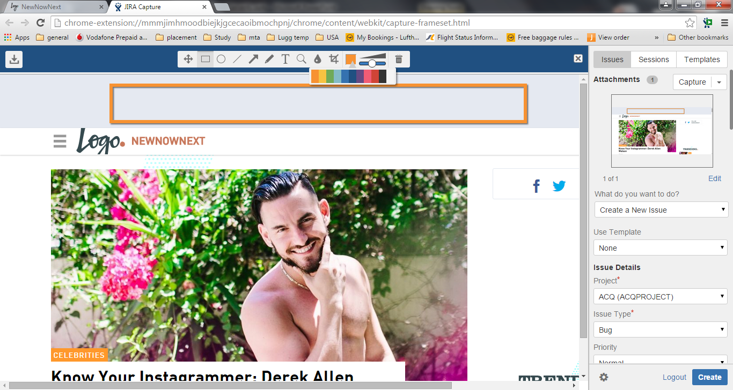
JIRA Capture Plugin
Creating a defect using JIRA capture:

Slide 28
JIRA Capture Plugin
Easily and automatically add Browser/OS version
Screenshots can be taken while testing is done.
Extra details such as highlighting a particular part, adding text, etc can be simply done with the in-built editor.
Multiple screenshots can also be attached simultaneously.
Screenshots can be attached to existing issues.

Slide 29

Feedback!!!
Questions!!!
Queries!!!

Slide 30


Thank You
Our Business Knowledge,
Your Winning Edge.

